Slide 1
Library Management System
Bachelor of Information Technology (External)
University of Moratuwa
E2245624
GHSK Wijesooriya

Slide 2
Introduction
Overview:
The Library Management System is designed to automate and streamline library operations.
It provides an efficient way to manage book inventory, user transactions, and overall library management.
Objective:
To enhance user experience and improve the efficiency of library operations.

Slide 3
Features
Key Features:
1. User Registration and Authentication: Allows users to create accounts and log in securely.
2. Book Search and Catalog Management: Users can search for books by title, author, or ISBN.
3. Borrowing and Returning Books: Users can borrow and return books with automated tracking.
4.Fine Calculation for Late Returns: Automatically calculates fines for overdue books.
5.Transaction History Tracking: Users can view their borrowing history.

Slide 4
Technology Stack
Frontend:
Java Swing (for the user interface)
Backend:
Java (for application logic)
Database:
MySQL (for data storage)
Development Tools:
Eclipse/IntelliJ IDEA (IDE)
Maven (for dependency management)

Slide 5
System Architecture
Diagram:
User Interface: Represents the front end where users interact.
Application Logic: The backend processing of requests.
Database: Where all data is stored.
Description:
The user interface communicates with the application logic, which in turn interacts with the database to perform operations.

Slide 6
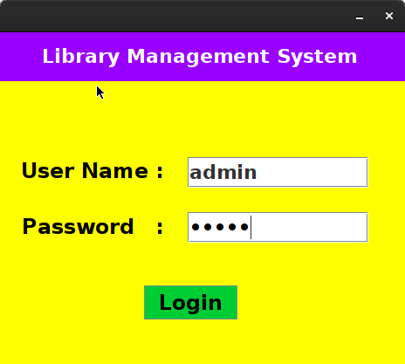
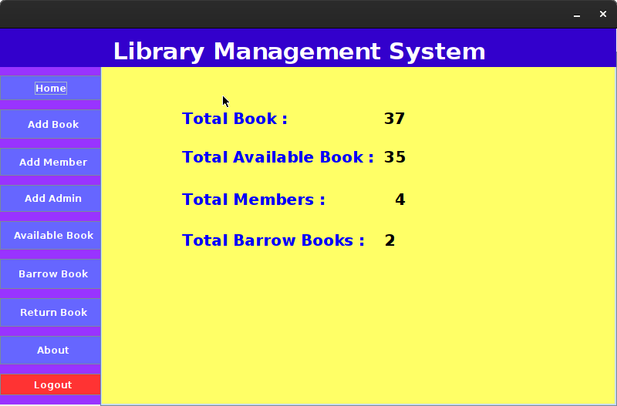
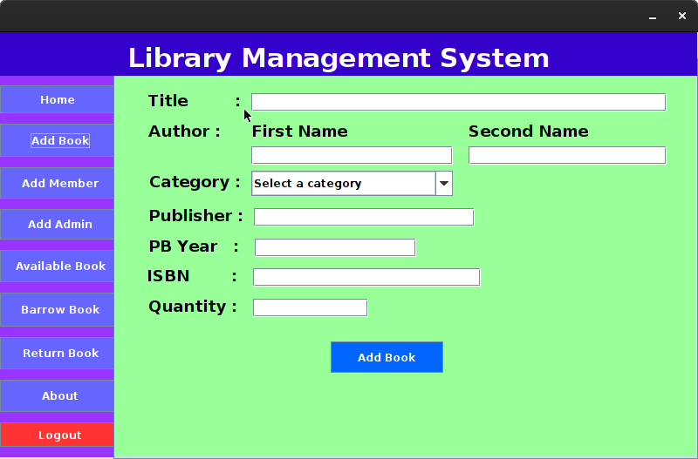
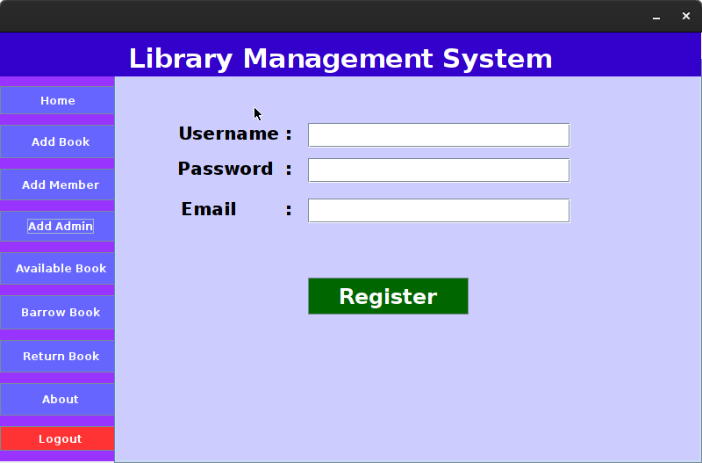
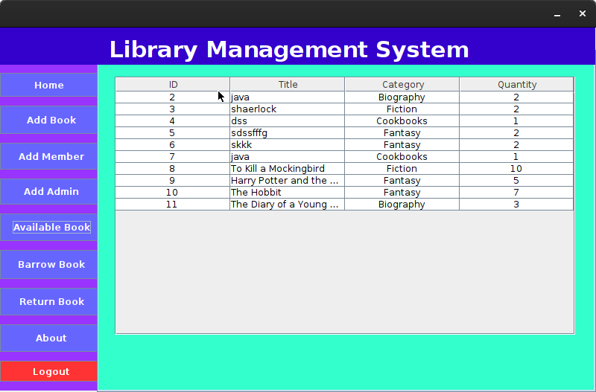
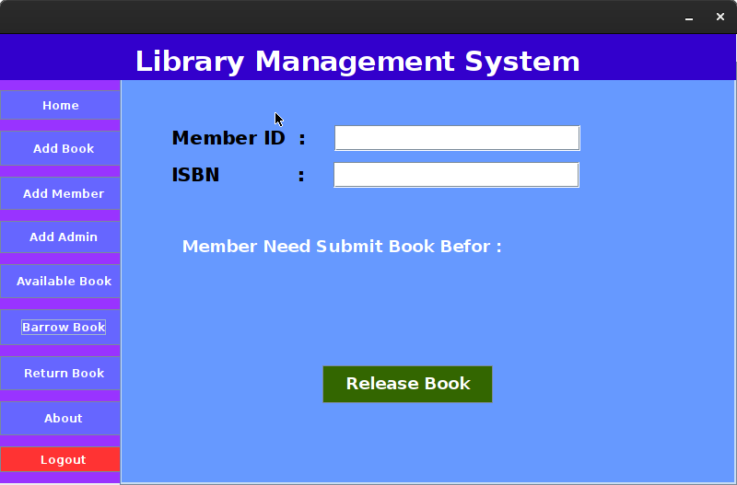
User Interface
The user interface is designed to be intuitive and user-friendly, allowing easy navigation through various functionalities.

Slide 7
Challenges Faced
Technical Challenges:
Database Integration: Ensuring smooth communication between the application and the database.
UI Design: Creating a responsive and user-friendly interface.
Solutions:
Utilized JDBC for effective database connectivity.
Iterated on UI design based on user feedback.

Slide 8
Future Enhancements
Potential Features:
* Online Catalog Access: Allow users to browse the catalog online.
* Mobile Application Version: Develop a mobile-friendly version of the application.
* Advanced Reporting Features: Generate reports on overdue books, popular titles, etc.
* Integration with External APIs: Fetch book information from online databases.

Slide 9
Conclusion
Summary:
The Library Management System effectively automates library operations, making it easier for users to manage their borrowing activities.
It enhances the overall efficiency of library management.

Slide 10
Thank You

